Slide 1
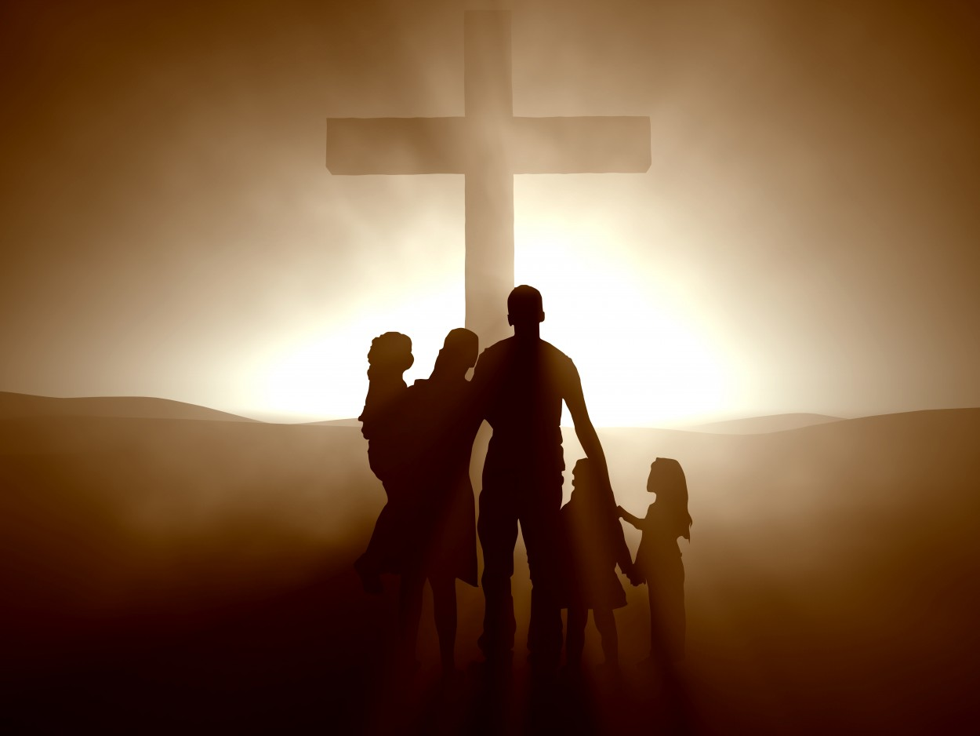
Be Restored
Haggai
Dr. Rick Griffith, Crossroads International Church Singapore
BibleStudyDownloads.org

Slide 2
Sometimes things don't go our way even when we follow God's leading.
Notes:
You moved to Singapore because God clearly called you.
He made that abundantly evident that you—not someone else more qualified—got the privilege. So you obeyed and came.
But then you discovered that this place is far more expensive than anyone ever let on. It’s also hotter—and wetter. And the relationships that started sweet began to sour, and here you are. Things are hard.
Is God trying to get your attention?
Perhaps you didn’t choose to move here at all. You got a special blessing. You were born here.
But the LORD gave you an opportunity to serve elsewhere for a while. It changed you for the better.
But now you’re back and this country doesn’t seem so special. You find yourself more able to relate to foreigners than to your own people. Believe me, I understand. When return to my country of origin, I don’t fit there. I wonder if I fit anywhere. Is God disciplining me?

Slide 3
Is God trying to get your attention despite the sacrifices you've made for him?
Notes:
You have been faithful to him, as far as you know. You have obeyed.
You weren’t so thrilled to come to a church with an afternoon service that stole your Sunday nap, but you still come.
But things aren’t going so well at home, or work, or with friends, or with someone special to you.
“What’s happening to me?” you ask. “Is God speaking to me through difficulty? What’s he trying to say? What do I do?”

Slide 4

How can you restore God's
BLESSING when you only see his discipline?

Slide 5
Background
Notes:
You aren’t the first one that’s needed to be restored. In today’s text, Judah had faithfully returned to their homeland but the people were still not seeing his full blessing.

Slide 6

MINOR PROPHETS
with a
MAJOR MESSAGE
Notes:
The historical context is a mixed bag.
We’ve been in this series on the Minor Prophets lately.

Slide 7
OT Overall Timeline
h
Haggai
520
United Kingdom
1050-930
Divided Kingdom
930-722
Solitary Kingdom
722-586
Post- Exile
536-425
1100
1050
1000
950
900
850
800
7 5 0
7 0 0
650
600
550
500
450
Exile 586-536
Notes:
These prophets stretch nearly the entirety of Israel’s history. Most were ignored, from the United Kingdom Golden Age under David and Solomon, then ignored after the nation divided, then ignored when Judah was the Solitary kingdom.

Slide 8
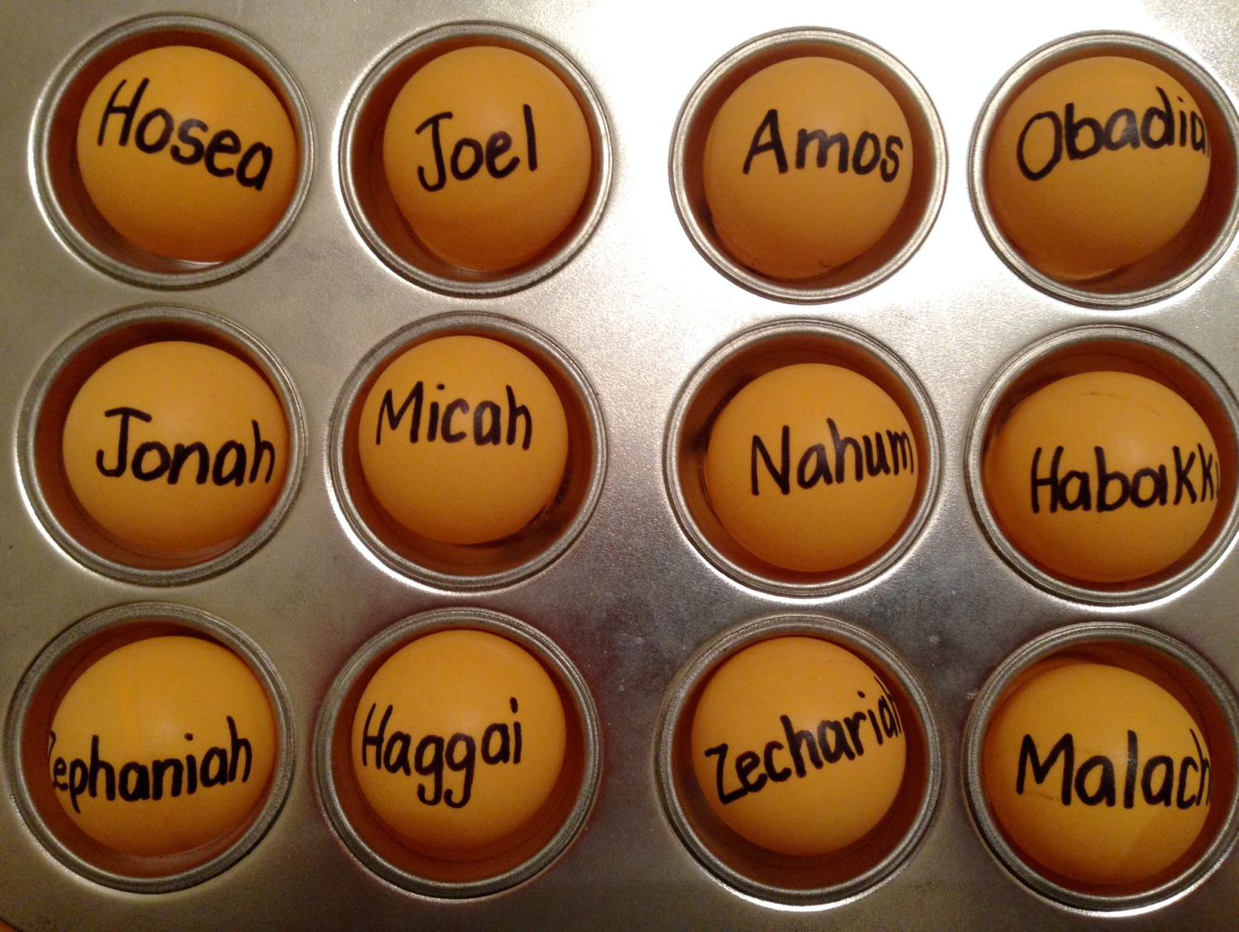
Be...
Loyal
Disciplined
Just
Humble
Caring
Generous
Patient
Amazed
Hopeful
Restored
Notes:
Their ancestors had not heeded the nine prophets we have already studied. Through varying prophets, God had told them to be…humble, caring, etc. Yet they stubbornly worshipped idols and God, faithful to his warning, sent them away to Babylon in modern-day Iraq.

Slide 9

Two 70-Year Exiles
560
Two 70-Year Exiles
People Exile
605
586
539
536
516
Temple Exile
Notes:
But the people and temple exiles were not permanent. God promised to restore them because the exiles would last only 70 years, and the time and opportunity to return had come to return home. Remember centuries earlier when Israel entered Canaan and had 600,000 soldiers? Now, only 50,000 men of Judah had trusted the LORD to bring them back to Israel.

Slide 10
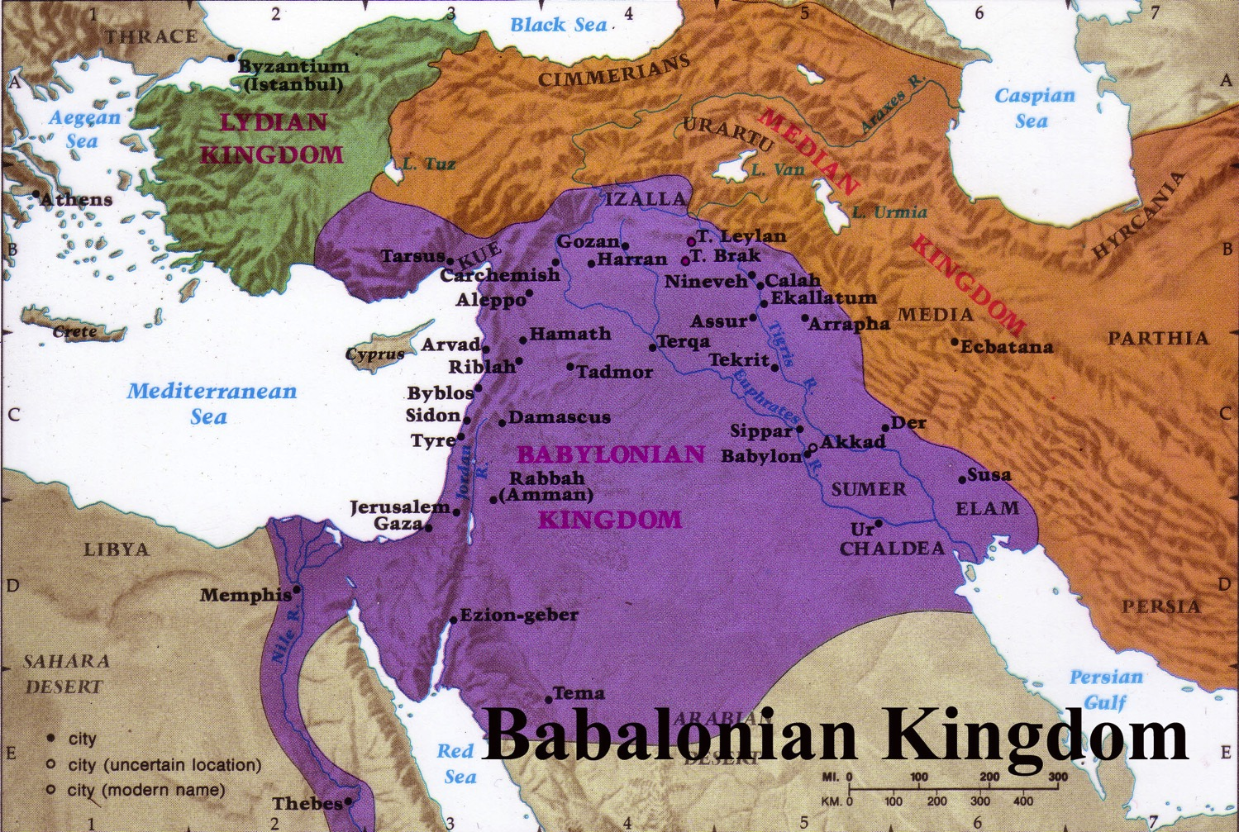
Exile Deportations & Developments
641
Deportations
Developments
Separation
Synagogue
No more idolatry
Even though they had synagogues, Jews still wanted to restore the Jerusalem temple
Exiles led by Zerubbabel returned to the land of Judah after the decree of the Persian emperor Cyrus in 539 BC. The returned exiles started the reconstruction of the temple by laying its foundation (Ezra 5:16).
Notes:
In some sense, you can’t blame them. They had separated from idolatry, developed the synagogue, and been cured of idolatry. Besides these, they were making good money in Babylon—so who would want to return to a ruined country? No money, no homes, no friends—just enemies occupying their country now. But they still came, and they trusted God’s leading. They eagerly rebuilt the temple foundation and altar in 536 BC.

Slide 11
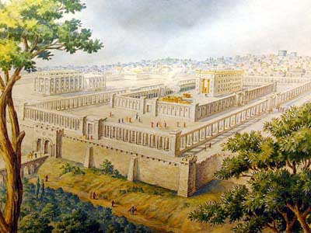
Opposition to Rebuilding
641
External
Notes:
However, opposition struck externally from pagans left in the land as recorded in Ezra 4.

Slide 12
The Context:
Opposition to Temple Rebuilding
536 BC: As soon as the copy of the letter of King Artaxerxes was read to Rehum and Shimshai the secretary and their associates, they went immediately to the Jews in Jerusalem and compelled them by force to stop. Thus the work on the house of God in Jerusalem came to a standstill until the second year of the reign of Darius king of Persia [520 BC].
Ezra 4:23-24 (NIV)

Slide 13
Opposition to Rebuilding
641
Internal
Notes:
Next week we will see the external threats in the book of Zechariah, but today we address the internal problems within the community itself. Often our most severe problems lie within our own midst!
These issues had already stopped the temple project for 16 years. They had started well, but made excuses and forgot God.
God hadn’t forgotten them though. He finally speaks in his land

Slide 14
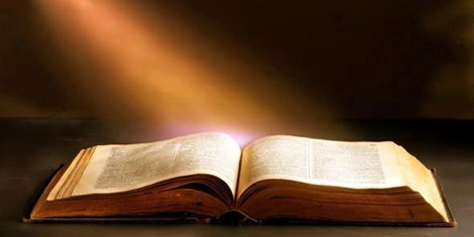
"On August 29 of the second year of King Darius's reign, the LORD gave a message through the prophet Haggai to Zerubbabel son of Shealtiel, governor of Judah, and to Jeshua son of Jehozadak, the high priest" (1:1 NLT).
Notes:
The word came to the governor.

Slide 15


The Postexilic Era
295-296
The Postexilic Era
Temple work
Prophets:
Haggai
Zechariah
605
586
539
536
520
516
Others:
Zerubbabel
Persian Kings:
Cyrus
Darius
Notes:
This was King Darius’s second year, in 520 BC (1:1)

Slide 16
Prophecy #1: God Speaks Regarding Temple Neglect
8/29
1:1
Aug
Sep
Oct
Nov
Dec
520 B.C.
Notes:
It was the first of four messages through Haggai that year.

Slide 17
Placing the Prophets
Placing the Prophets
342
Key Dates
931
Obadiah
722
Jonah
Amos
Hosea
Isaiah
Micah
Nahum
Zephaniah
Jeremiah
Lamentations
Joel
Daniel
Haggai
Habakkuk
Ezekiel
586
Notes:
This book interrupts the 50+ silent years of prophets in Judah while the people were exiled to Babylon. God was ready to tell them how to restore his blessing. Would they listen?
They had come back to the land, but they had not fully come back to the LORD of the land.

Slide 18

Would they listen?
God speaks today too.
Are we listening?
Notes:
The context may sound familiar since our faithfulness often is also a mixed bag.
Our salvation begins when we believe the simple message of trust in Christ instead of trusting ourselves. The people of Judah had that kind of faith—placed their trust in YHWH instead of the worthless gods of the pagans.
However, that was but a start for them, as it is for us. God has so much more in store for us, so Haggai shows how to realign with his priorities for blessing.

Slide 19
Parallel Structure
642
The oracles have two parallel structures: the first and third focus on accusation, while the second and fourth focus on God's assurance:
Oracle 1 Accusation (1:1-15)
Oracle 2 Assurance (2:1-9)
Oracle 3 Accusation (2:10-19)
Oracle 4 Assurance (2:20-23)
Notes:
Haggai alternates from rebuke to promise to rebuke to promise in a four-fold pattern to restore his blessing. That makes four ways to restore God’s blessing.

Slide 20
Drought for Neglecting Temple Rebuilding
640
Drought for Neglected Temple Rebuilding
Temple |  | Blessings
Wrong Priorities | Greater Glory | Drought Judgment | Zerubbabel's Authority
1 | 2:1-9 | 2:10-19 | 2:20-23
Rebuke #1 | Promise #1 | Rebuke #2 | Promise #2
"Is it a time for you… to be living in your panelled houses, while this house remains in ruins? …Go… and build the house" (1:4, 8a) | "I will fill this house with glory…The glory of this present house will be greater than the glory of the former house" (2:7b, 9a) | "Whatever [my people] do and whatever they offer is defiled… [yet] from this day on I will bless you" (2:14b, 19b) | "I will shake the heavens and the earth. I will overturn royal thrones and shatter the power of the foreign kingdoms" (2:21-22)
Present | Kingdom | Present | Kingdom
Drought | Sadness | Food Shortage | Leadership
August 29, 520 BC | October 17, 520 BC | December 18, 520 BC | December 18, 520 BC
Jerusalem
Notes:
Today we’ll study the entire prophecy of Haggai.

Slide 21
Slides on
Haggai 1

Slide 22
How can you restore God's
BLESSING when you only see his discipline?
Notes:
This short book will show how you can restore God’s blessing when you only see his discipline. The first thing you need to do is to…

Slide 23

1. Realign your priorities (Haggai 1).
Notes:
Seeking your own comforts first invites the LORD's reproof.

Slide 24
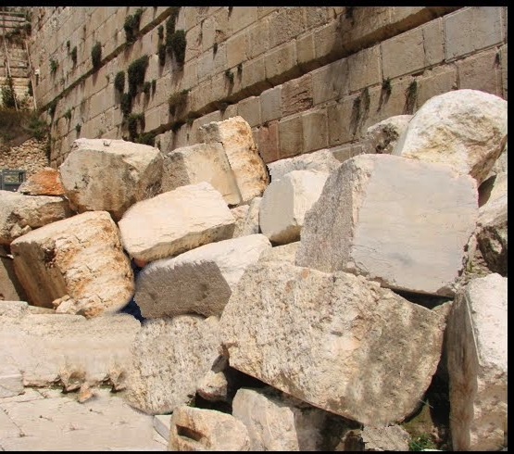
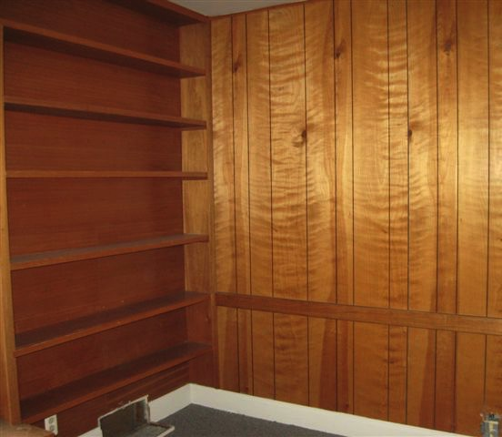
Oracle 1: Accusation
642
"This is what the LORD of Heaven's Armies says: The people are saying, 'The time has not yet come to rebuild the house of the LORD'" (Haggai 1:2).
"Then the LORD sent this message through the prophet Haggai: ⁴'Why are you living in paneled houses while my house lies in ruins?'" (Haggai 1:3-4).

Slide 25

Jewish life revolved around Solomon's temple for 400 years (959-586 BC)
Judaism in Israel and the Diaspora

Slide 26
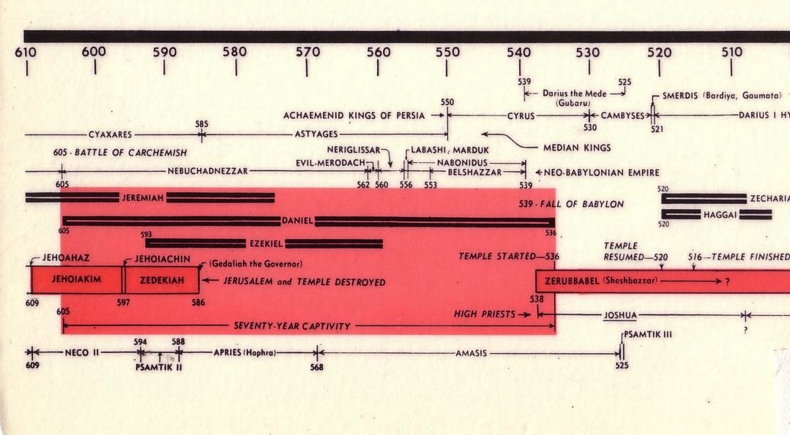
Chart of the Exile
232 & 342
The Babylonian Exile
John C. Whitcomb, 4th rev. ed., Winona Lake, IN: BMH Books, 1962, 1968

Slide 27

Jews Maintained Holiness at the Basin
Temple Destroyed!

Slide 28
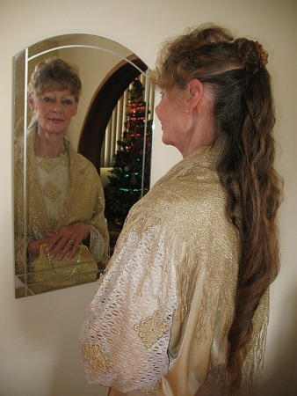
The Problem in Haggai's Day…
641
Due to opposition from nearby enemies, the temple was never finished. For 16 years the priority of building God's temple had gradually diminished.
Although some returning Jews may have been poor, some still had some level of affluence. People had paneled their private homes like Solomon had done in the temple and palace (Hag. 1:4; cf. 1 Kings 6:9; 7:3,7).

Slide 29
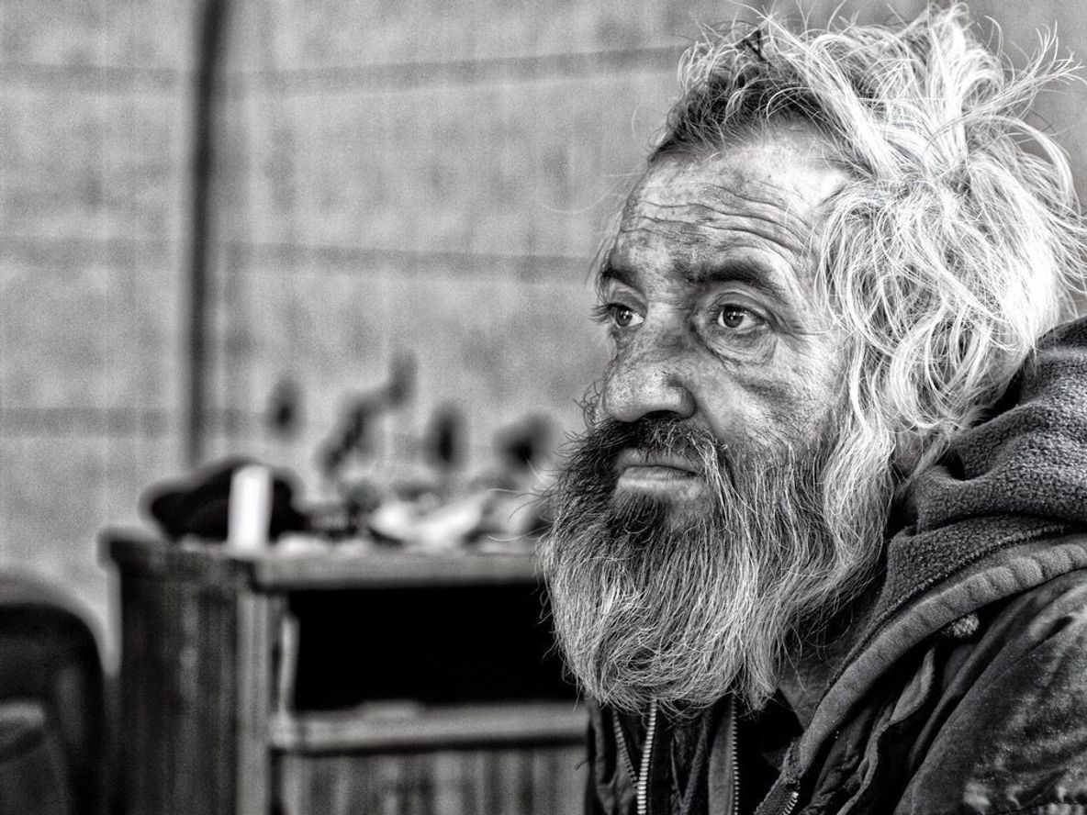
"This is what the LORD of Heaven's Armies says: Look at what's happening to you! ⁶ You have planted much but harvest little. You eat but are not satisfied. You drink but are still thirsty. You put on clothes but cannot keep warm. Your wages disappear as though you were putting them in pockets filled with holes!" (Haggai 1:5-6 NLT).
Notes:
The remnant’s wrong priorities by paneling their own houses instead of rebuilding the temple resulted in a dire economy (1:2-6).

Slide 30
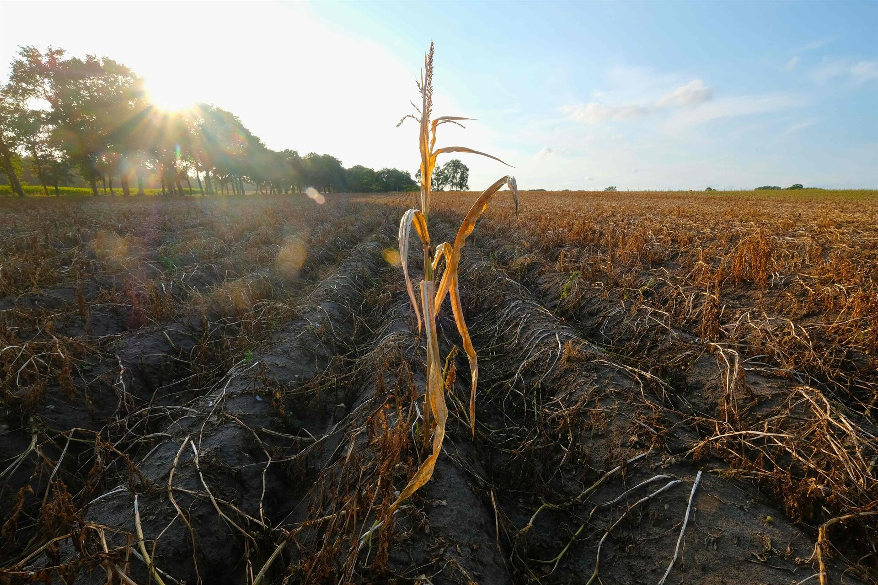
"This is what the LORD of Heaven's Armies says: Look at what's happening to you! ⁸Now go up into the hills, bring down timber, and rebuild my house. Then I will take pleasure in it and be honored, says the LORD. ⁹You hoped for rich harvests, but they were poor. And when you brought your harvest home, I blew it away. Why? Because my house lies in ruins, says the LORD of Heaven's Armies, while all of you are busy building your own fine houses" (Haggai 1:7-9 NLT).
Notes:
The people’s financial poverty was shown to be from postponing the temple rebuilding so that they would resume the task to please God and eliminate the drought (1:7-11).

Slide 31
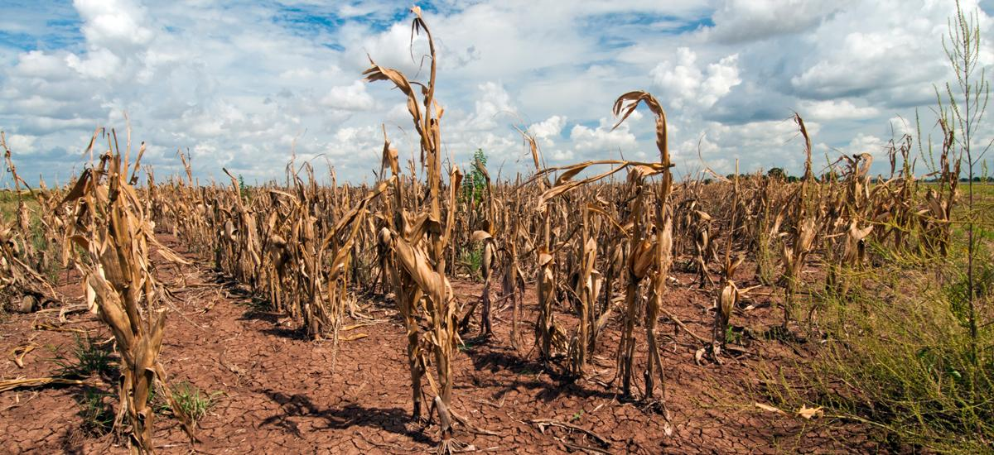
"It's because of you that the heavens withhold the dew and the earth produces no crops. ¹¹ I have called for a drought on your fields and hills—a drought to wither the grain and grapes and olive trees and all your other crops, a drought to starve you and your livestock and to ruin everything you have worked so hard to get" (Haggai 1:10-11 NLT).

Slide 32
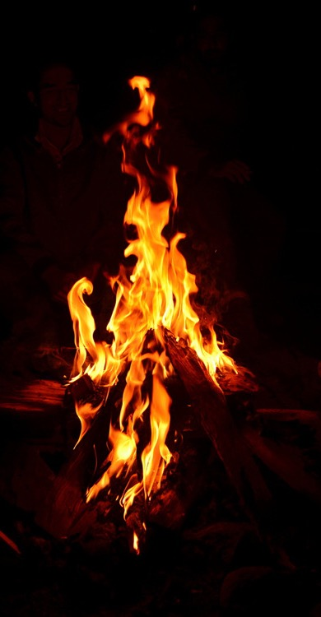
"Then Zerubbabel son of Shealtiel, and Jeshua son of Jehozadak, the high priest, and the whole remnant of God's people began to obey the message from the LORD their God. When they heard the words of the prophet Haggai, whom the LORD their God had sent, the people feared the LORD. ¹³Then Haggai, the LORD's messenger, gave the people this message from the LORD: 'I am with you, says the LORD!’”
(Haggai 1:12-13 NLT).

Slide 33
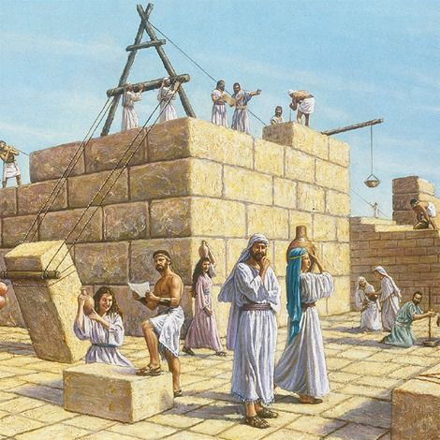
"So the LORD sparked the enthusiasm of Zerubbabel son of Shealtiel, governor of Judah, and the enthusiasm of Jeshua son of Jehozadak, the high priest, and the enthusiasm of the whole remnant of God's people. They began to work on the house of their God, the LORD of Heaven's Armies, ¹⁵on September 21 of the second year of King Darius's reign"
(Haggai 1:14-15 NLT).

Slide 34

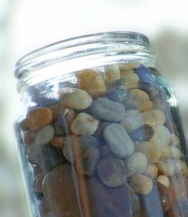
Oracle 1: Accusation
642
Notes:
The teacher pulled out a large jar and placed it on the table. He put several large rocks into the jar—then some smaller ones, then sand, then water to the brim.
"What's the lesson?" he asked the class.
One enterprising student answered, "No matter what you may think, you can always fit more in!"
"No," the professor responded. "You have to put the large rocks in first!"
Priorities are like that. If you don't put them first, they won't get done.
And if they don't get done, then they are not the priorities, are they?

Slide 35
See the invisible!
"So we fix our eyes
not on what is seen,
but on what is unseen.
For what is seen is temporary,
but what is unseen is eternal"
(2 Corinthians 4:18)

Slide 36

Money

Slide 37
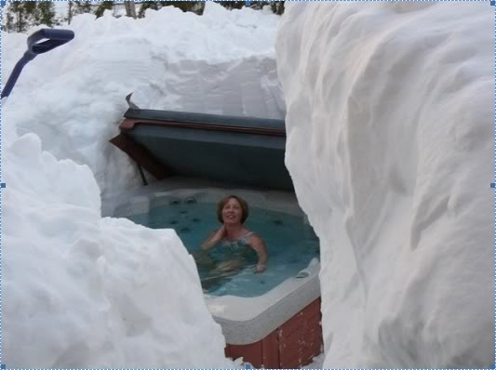
Key Word
640
343
Priorities
Haggai

Slide 38
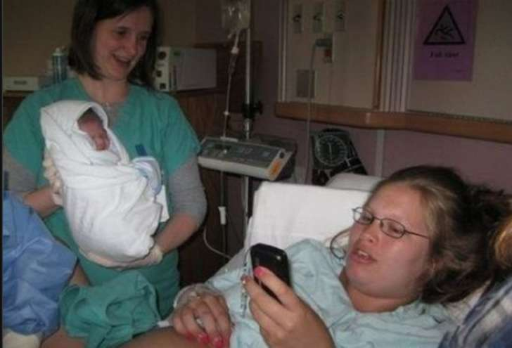
Key Word
640
343
Priorities
Haggai

Slide 39
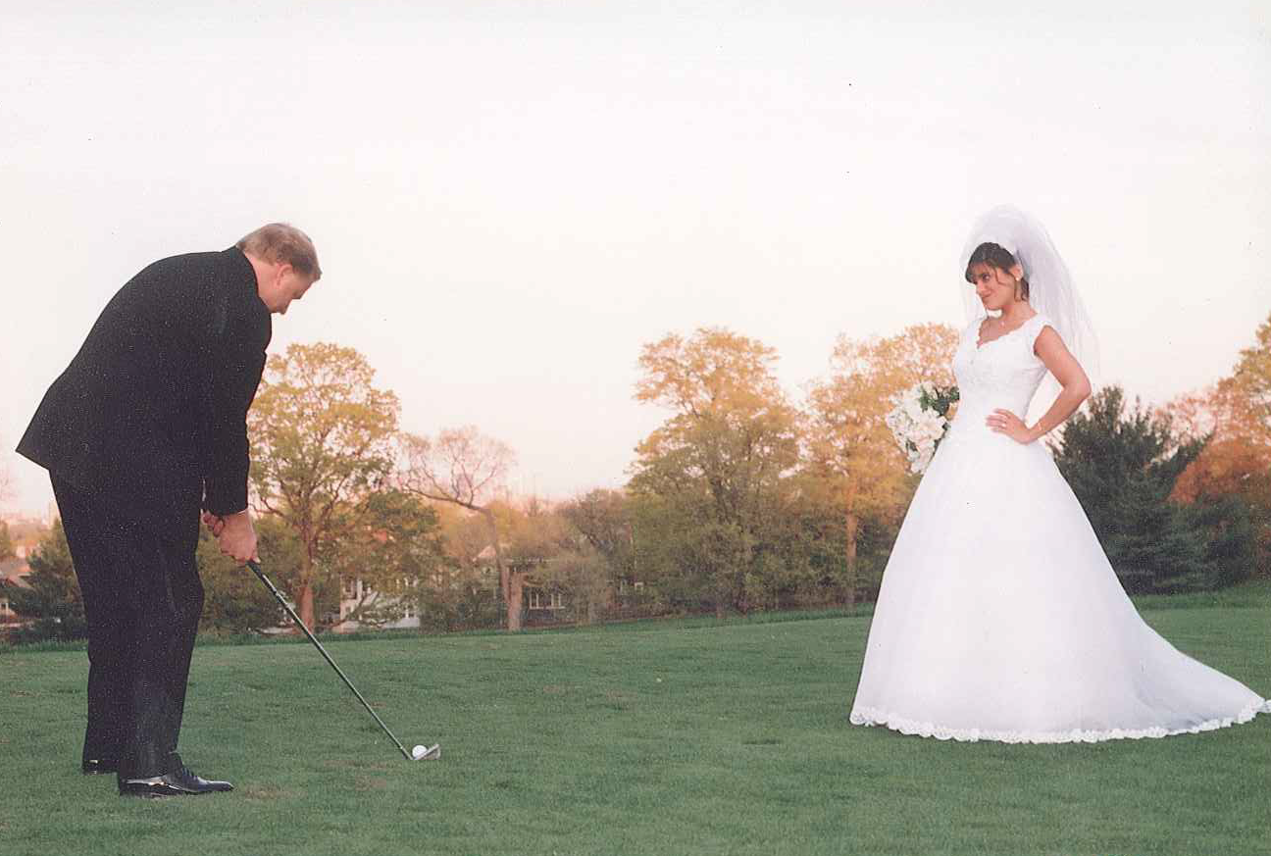
Key Word
640
343
Priorities
Haggai

Slide 40
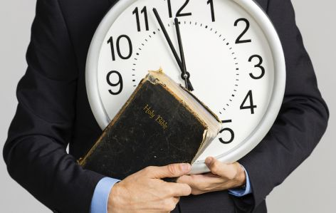
Prioritize Your Time

Slide 41
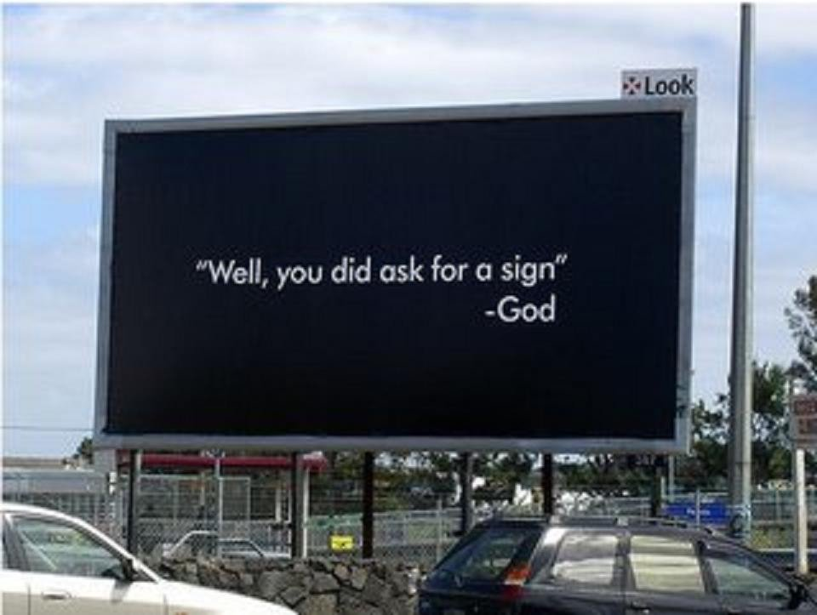
"Well, you did ask for a sign"
—God

Slide 42
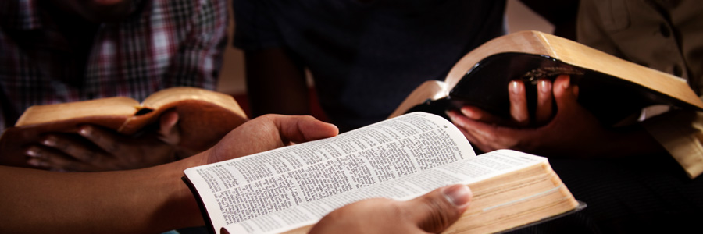
God still speaks. Read his words.

Slide 43

God still speaks when we are still.

Slide 44
How can you restore God's
BLESSING when you only see his discipline?

Slide 45
1. Realign your priorities (Haggai 1).
Notes:
Seeking your own comforts first invites the LORD's reproof.

Slide 46
Slides on
Haggai 2

Slide 47

2. Recall God's presence (Haggai 2:1-9).
Notes:
If you have trusted Christ, the LORD guarantees that he is with you—so don't forget that.

Slide 48

"Then on October 17 of that same year, the LORD sent another message through the prophet Haggai. 'Say this to Zerubbabel son of Shealtiel, governor of Judah, and to Jeshua son of Jehozadak, the high priest, and to the remnant of God's people there in the land'"
(Haggai 2:1-2 NLT).

Slide 49
Dates in Haggai
8/29
1:1
9/21
1:15
10/17
2:1
Aug
Sep
Oct
Nov
Dec
520 B.C.

Slide 50
"'Does anyone remember this house—this Temple—in its former splendor? How, in comparison, does it look to you now? It must seem like nothing at all! ⁴But now the LORD says: Be strong, Zerubbabel. Be strong, Jeshua son of Jehozadak, the high priest. Be strong, all you people still left in the land. And now get to work, for I am with you, says the LORD of Heaven's Armies. ⁵My Spirit remains among you, just as I promised when you came out of Egypt. So do not be afraid'"
(Haggai 2:3-5 NLT).

Slide 51
"'For this is what the LORD of Heaven's Armies says: In just a little while I will again shake the heavens and the earth, the oceans and the dry land. ⁷I will shake all the nations, and the treasures of all the nations will be brought to this Temple. I will fill this place with glory, says the LORD of Heaven's Armies'" (Haggai 2:6-7 NLT).

Slide 52
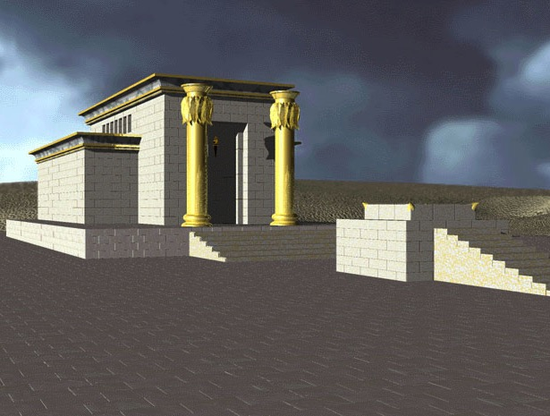
1st Temple - Solomon

Slide 53
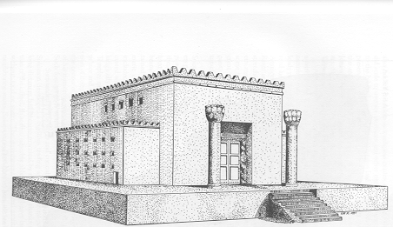
2nd Temple - Zerubbabel

Slide 54

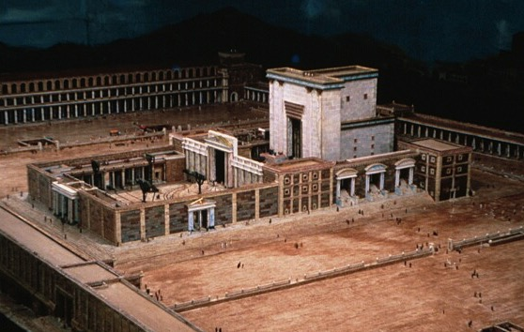
2nd Temple - Herod

Slide 55
God's Presence in Temple Rebuilding
Admonition 1:1-15
Consolation 2:1-9
Affirmation 2:10-19
Anticipation 2:20-23
Haggai
Present 1-5
Response 12-15
Rebuke 1-11
Building
Blessings
520 B. C.
First things first

Slide 56
"'The silver is mine, and the gold is mine, says the LORD of Heaven's Armies. ⁹The future glory of this Temple will be greater than its past glory, says the LORD of Heaven's Armies. And in this place I will bring peace. I, the LORD of Heaven's Armies, have spoken!'"
(Haggai 2:8-9 NLT).

Slide 57

Oracle 2: Assurance
642
Despite their poverty and inferior rebuilding of the temple, God reminded them of his previous promise that he will be with them and encouraged them to continue (2:1-5).
He will shake the heavens and use all the silver and gold of nations to beautify and glorify the temple (2:6-9)

Slide 58
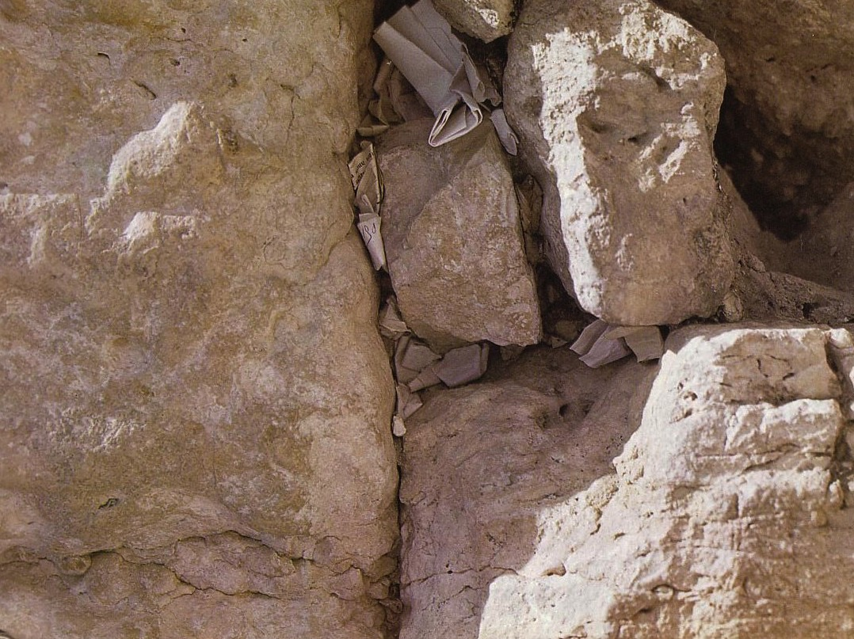
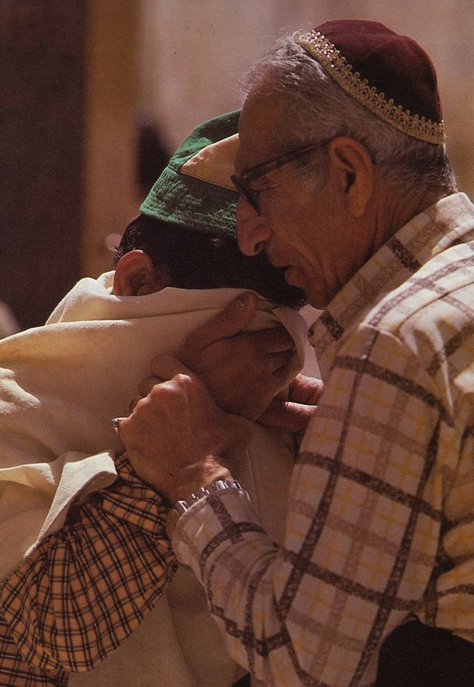
Prayers for the Third Temple
While praying for temple restoration Jews needed a common place to bring themselves "together" (syn) to preserve their "way of life" (agoge). Thus the "synagogue" was born.

Slide 59
"I will fill this house with glory" (2:7)
Admonition 1:1-15
Consolation 2:1-9
Affirmation 2:10-19
Anticipation 2:20-23
Haggai
Present 1-5
Future 6-9
Response 12-15
Rebuke 1-11
Building
Blessings
520 B. C.
First things first

Slide 60
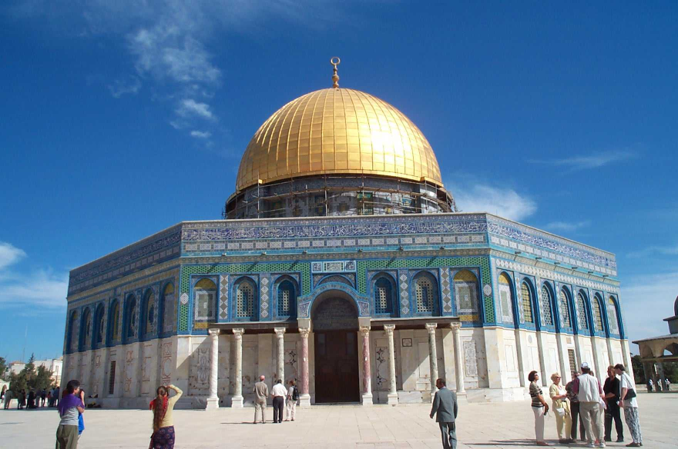
Replace This with a Temple?
Good luck!

Slide 61
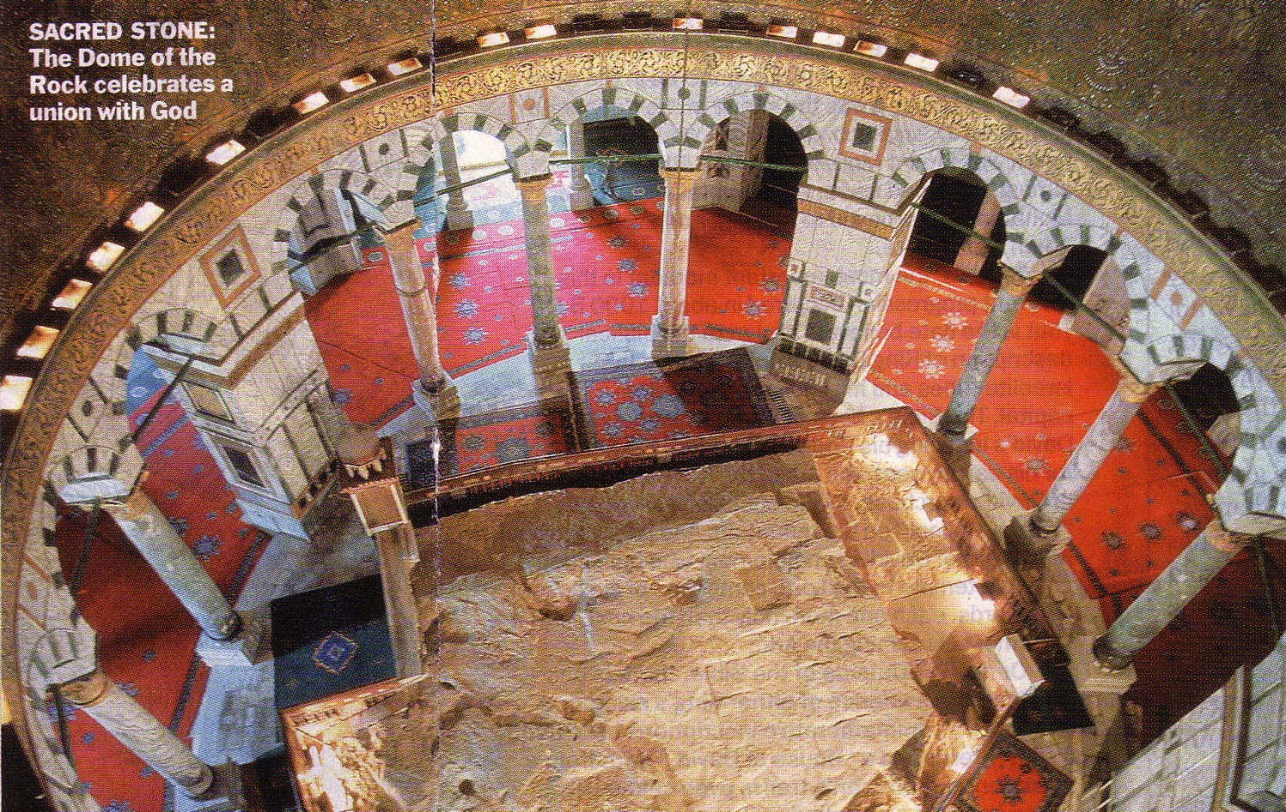
The Rock Inside
SACRED STONE:
The celebrates a union with God
24

Slide 62

Modern Temple Mount
644a
Northern Location
Eastern Gate
Traditional Location
N
E
W
S

Slide 63
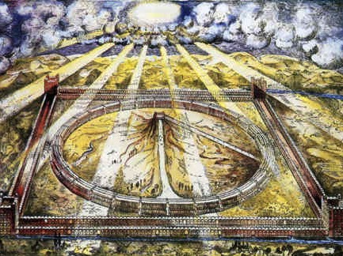
Ezekiel
The Temple of Ezekiel 40–47

Slide 64
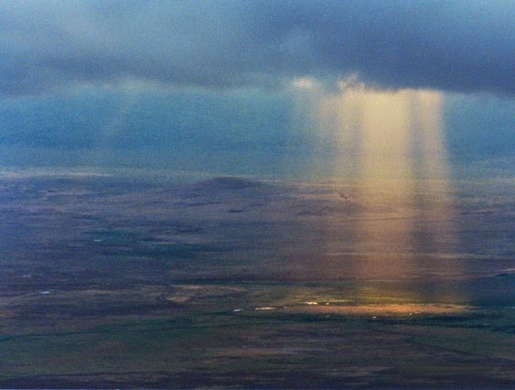
God's Glory Will Return!

Slide 65


The Glory Returns
502
656
Ezekiel

Slide 66
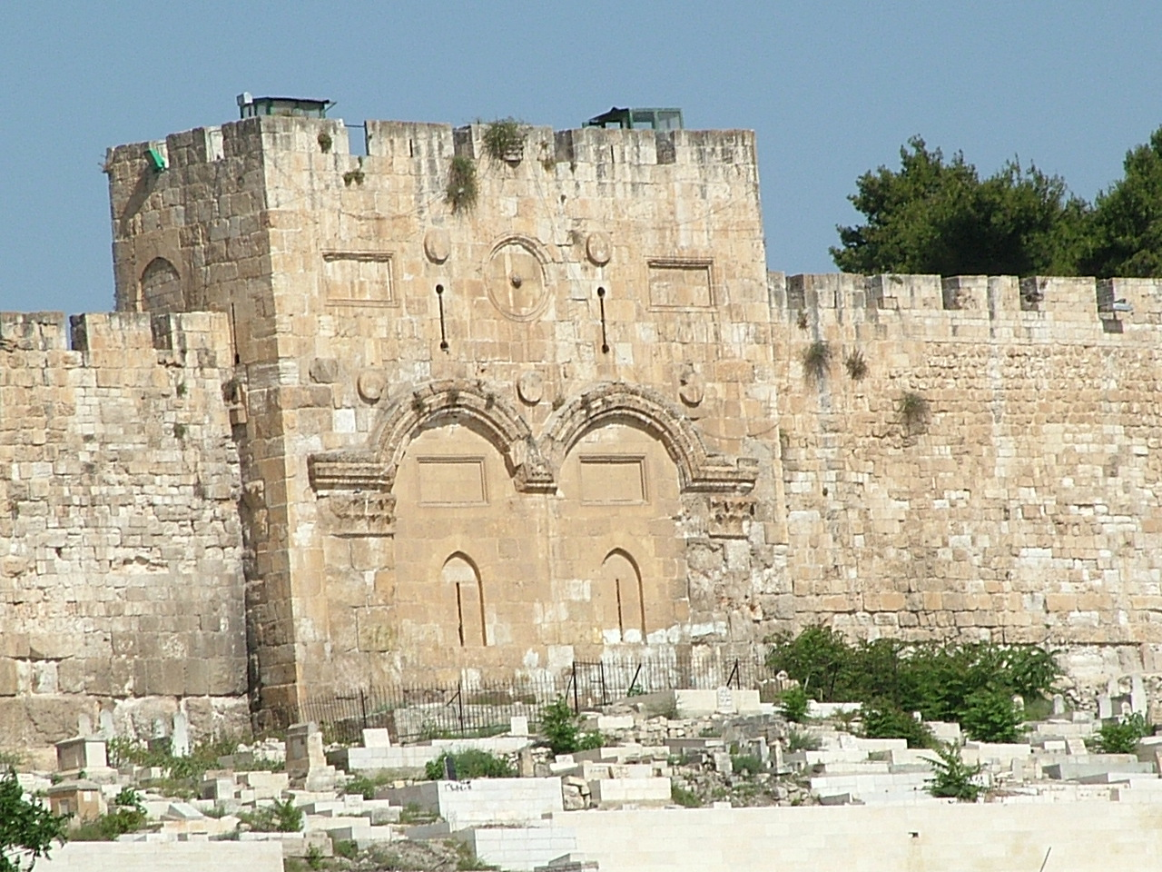
The Eastern Gate (Ezek. 43:1-4 NLT)
"After this, the man brought me back around to the east gateway. ²Suddenly, the glory of the God of Israel appeared from the east. The sound of his coming was like the roar of rushing waters, and the whole landscape shone with his glory. ³This vision was just like the others I had seen, first by the Kebar River and then when he came to destroy Jerusalem. I fell face down on the ground. ⁴And the glory of the LORD came into the Temple through the east gateway."

Slide 67
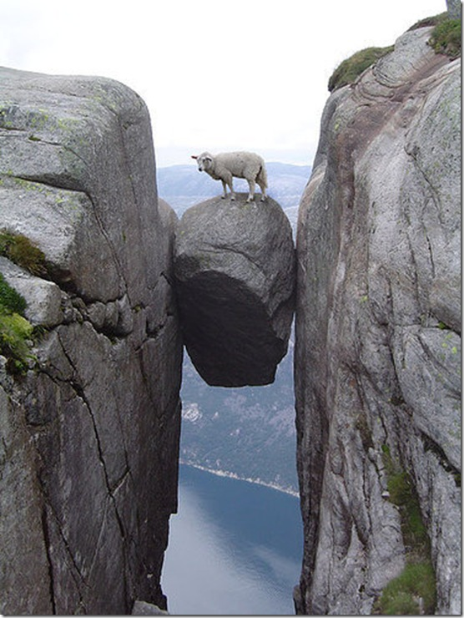
Recall that God also has promised you his presence today.

Slide 68
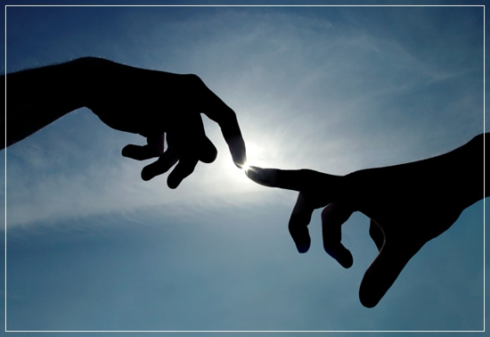
God's Presence
Therefore, the larger context of Haggai's message concerns the presence of God.
Coggins notes, "God gives assurance of His lasting presence with them by recounting the past history of his dealings with them (' the promise that I made you when you came out of Egypt'), by assuring the present reality ('my Spirit abides among you; fear not'), and by promising a sign of future glory ('I will shake all nations, so that the treasures of all nations shall come in' [2:21])."

Slide 69
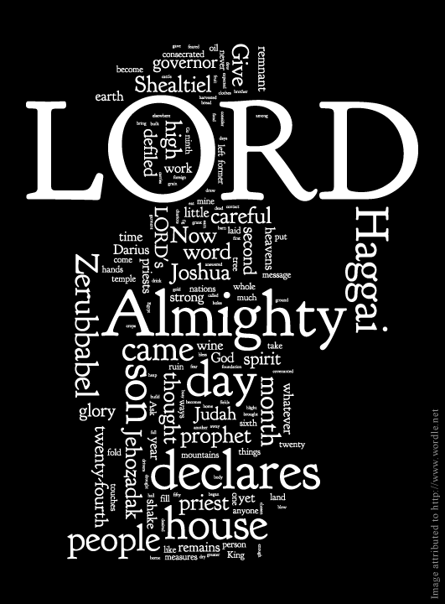
The LORD of Hosts
The divine name Yahweh (LORD) occurs 34 times in the 38 verses of this book, and 14 of these stress divine omnipotence with the name the LORD of Hosts.
The LORD will yield up the nations' treasures to beautify and glorify his temple. He will shake the heaven and earth to do a great and cosmic thing.

Slide 70


"Don't love money; be satisfied with what you have. For God has said,
'I will never fail you. I will never abandon you'"
(Hebrews 13:5 NLT).
Notes:
"Let's look at just a few facts: Americans have 3 times more space than they did 50 years ago. Yet there's a booming $22 Billion dollar/year Storage Space industry. Which means we have, on average, more than 3 times the stuff, still need extra storage and are willing to pay extra for it. At the same time, credit card debt levels and, not surprisingly, stress levels have gone way up.
Also not surprisingly, happiness levels have flatlined in the last 50 years. Human greed was, perhaps, more glaringly visible than ever before, as the direct source of the last Global Recession. Has humanity looked at that and drastically changed it's MO? Have we looked at ourselves, and wondered how much of that stuff might have trickled into the Church?"
Money Talk – 4 Ways To Stop Loving Money
06/02/2014
http://austinchristian.org/money-talk-4-ways-to-stop-loving-money/

Slide 71
How can you restore God's
BLESSING when you only see his discipline?

Slide 72
1. Realign your priorities (Haggai 1).
Notes:
Seeking your own comforts first invites the LORD's reproof.

Slide 73
2. Recall God's presence (Haggai 2:1-9).
Notes:
If you have trusted Christ, the LORD guarantees that he is with you—so don't forget that.

Slide 74

3. Renew your worship (Haggai 2:10-19).

Slide 75
Dates in Haggai (2:10, 18, 20)
8/29
1:1
9/21
1:15
10/17
2:1
12/18
2:10, 18, 20
Aug
Sep
Oct
Nov
Dec
520 B.C.

Slide 76
Divine Discipline (2:10-17)
Admonition 1:1-15
Consolation 2:1-9
Affirmation 2:10-19
Anticipation 2:20-23
Haggai
Present 1-5
Future 6-9
Response 12-15
Blight 10-17
Rebuke 1-11
Building
Blessings
520 B. C.
First things first

Slide 77
"On December 18 of the second year of King Darius's reign, the LORD sent this message to the prophet Haggai: ¹¹'This is what the LORD of Heaven's Armies says. Ask the priests this question about the law: ¹²'If one of you is carrying some meat from a holy sacrifice in his robes and his robe happens to brush against some bread or stew, wine or olive oil, or any other kind of food, will it also become holy?'" The priests replied, 'No.'
¹³Then Haggai asked, 'If someone becomes ceremonially unclean by touching a dead person and then touches any of these foods, will the food be defiled?' And the priests answered, 'Yes'"
(Haggai 2:10-13 NLT).

Slide 78
"Then Haggai responded, 'That is how it is with this people and this nation, says the LORD. Everything they do and everything they offer is defiled by their sin. ¹⁵Look at what was happening to you before you began to lay the foundation of the LORD's Temple. ¹⁶When you hoped for a twenty-bushel crop, you harvested only ten. When you expected to draw fifty gallons from the winepress, you found only twenty. ¹⁷I sent blight and mildew and hail to destroy everything you worked so hard to produce. Even so, you refused to return to me, says the LORD” (Haggai 2:14-17 NLT).

Slide 79
Divine Blessing (2:18-19)
Admonition 1:1-15
Consolation 2:1-9
Affirmation 2:10-19
Anticipation 2:20-23
Haggai
Present 1-5
Future 6-9
Response 12-15
Blessing 18-19
Rebuke 1-11
Blight 10-17
Building
Blessings
520 B. C.
First things first

Slide 80

"Think about this eighteenth day of December, the day when the foundation of the LORD's Temple was laid. Think carefully. ¹⁹I am giving you a promise now while the seed is still in the barn. You have not yet harvested your grain, and your grapevines, fig trees, pomegranates, and olive trees have not yet produced their crops. But from this day onward I will bless you'" (Haggai 2:18-19 NLT).

Slide 81
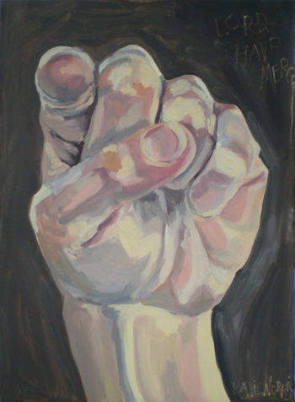
Oracle 3: Accusation
643
The problem: works and offerings are a false trust in human efforts and do not ensure acceptance by the LORD (2:10-14).
The consequences: economic shortage (2:16-17).
The response: The people responded by laying the temple foundation (2:18-19).

Slide 82

What does God think about your worship?
Notes:
We watch movies that destroy God’s values and then come to worship the next day.
Some believers withhold their tithe so they can have a better vacation.
Defiled worship today includes singing while trying to convince God to let you marry an unbeliever.

Slide 83
How can you restore God's
BLESSING when you only see his discipline?

Slide 84

4. Re-envision God's kingdom (Haggai 2:20-23).
Notes:
Focus again on the fantastic future the LORD has for you.

Slide 85
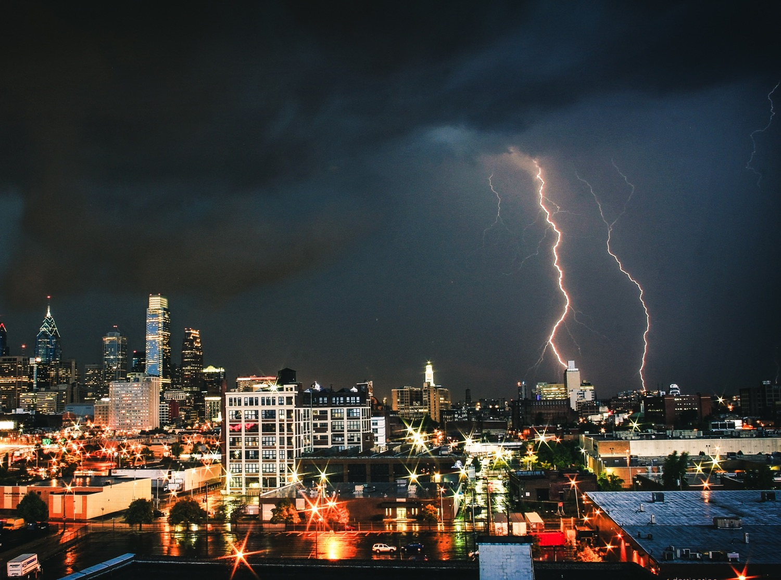
"On that same day, December 18, the LORD sent this second message to Haggai: ²¹'Tell Zerubbabel, the governor of Judah, that I am about to shake the heavens and the earth. ²²I will overthrow royal thrones and destroy the power of foreign kingdoms. I will overturn their chariots and riders. The horses will fall, and their riders will kill each other"
(Haggai 2:20-22 NLT).

Slide 86
Military Victory (2:20-22)
Admonition 1:1-15
Consolation 2:1-9
Affirmation 2:10-19
Anticipation 2:20-23
Haggai
Present 1-5
Future 6-9
Response 12-15
Blessing 18-19
Rebuke 1-11
Blight 10-17
Global 20-22
Building
Blessings
520 B. C.
First things first

Slide 87
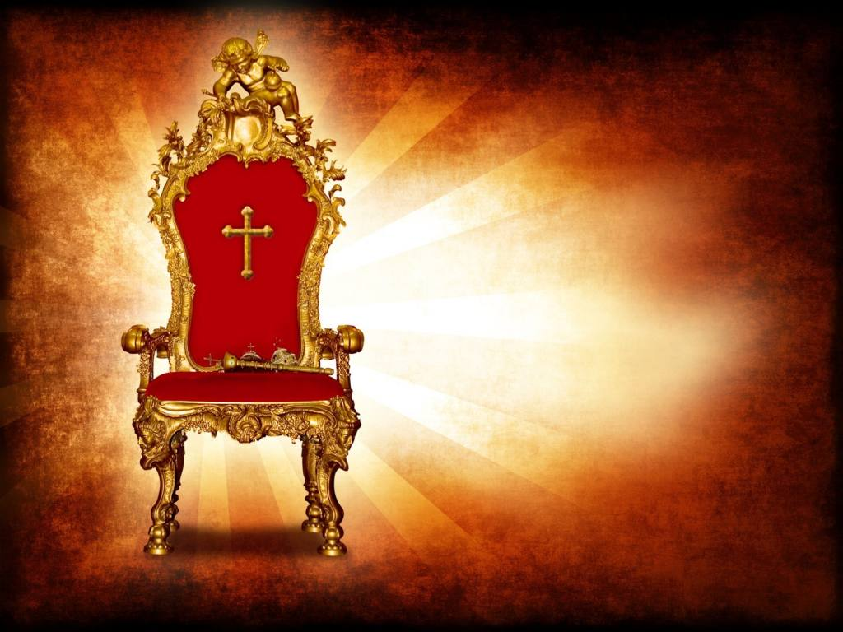
"But when this happens, says the LORD of Heaven's Armies, I will honor you, Zerubbabel son of Shealtiel, my servant. I will make you like a signet ring on my finger, says the LORD, for I have chosen you. I, the LORD of Heaven's Armies, have spoken!" (Haggai 2:23 NLT).

Slide 88

Oracle 4: Assurance
643
Again, God will shake the heavens and overthrow the nations (2:20-22)
He will also exalt the Davidic
line through Zerubbabel
(2:23)

Slide 89
Zerubbabel Blessed (2:23)
Admonition 1:1-15
Consolation 2:1-9
Affirmation 2:10-19
Anticipation 2:20-23
Haggai
Present 1-5
Future 6-9
Response 12-15
Blessing 18-19
Rebuke 1-11
Blight 10-17
Personal 23
Global 20-22
Building
Blessings
520 B. C.
First things first

Slide 90
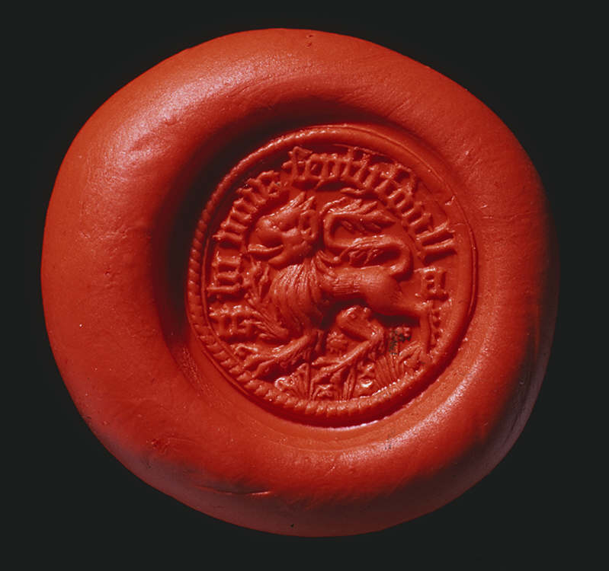

The Signet Ring
Impression from a Welsh signet ring found at Raglan, 15th century
Notes:
Impression at www.gtj.org.uk/ en/blowup7/14517 and the ring at www.ancientcoinvault.com/ modules.php?set_albu...

Slide 91
Zerubbabel's Authority
647
Haggai portrayed the Messiah when God said to Zerubbabel, "I will make you like my signet ring, for I have chosen you" (2:23). As a signet ring denoted authority, so Zerubbabel became the center of the Messianic line where both Joseph and Mary's lines merged:
David
In both genealogies the father of Zerubbabel is Shealtiel, but each genealogy follows a different son of Zerubbabel until they end with Joseph and Mary. This makes Zerubbabel and his father the common link in each lineage.
Solomon
Nathan
Shealtiel
(Matt. 1:12)
(Luke 3:27)
Zerubbabel
Joseph
Mary
Jesus
Talk Thru the Bible, 285

Slide 92
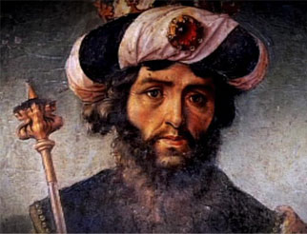
Significance of David-Zerubbabel Parallel
647
The parallel of David to Zerubbabel is outstanding, for David wanted to build the temple, but in response the LORD promised to build the king's house.
This similarity shows that the messianic element fits the context of the book.

Slide 93

Do you want God's blessing?
You will also inherit the kingdom when you are faithful now.

Slide 94
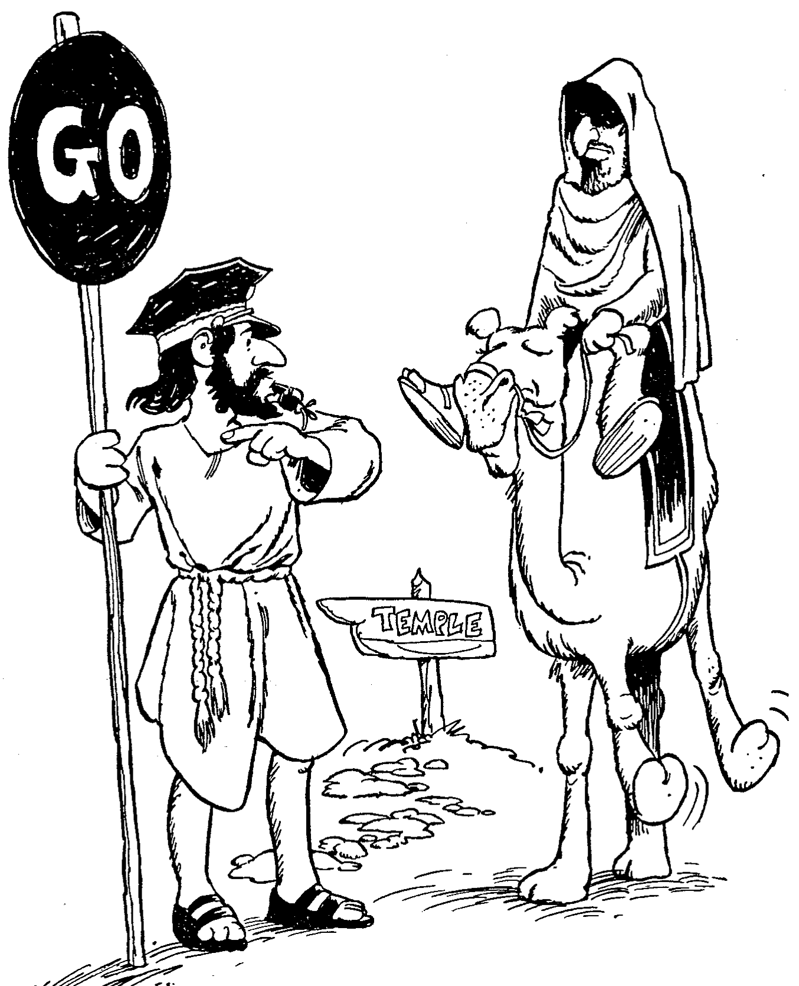
Barry Huddleston, The Acrostic Summarized Bible (Grand Rapids: Baker, 1992)
Haggai
1 God's temple needs building
2 Older temple less glorious

Slide 95
Two Types of Inheritance
"Now if we are children, then we are heirs—heirs of God and co-heirs with Christ, if indeed we share in his sufferings in order that we may also share in his glory"
(Rom. 8:17 NIV).
= Salvation
= Reward

Slide 96
How can you restore God's
BLESSING when you only see his discipline?

Slide 97

Main Idea
Align with God's priorities.
Notes:
God will restore you when you value what he values.

Slide 98
1. Realign your priorities (Haggai 1).
Notes:
Seeking your own comforts first invites the LORD's reproof.

Slide 99
2. Recall God's presence (Haggai 2:1-9).
Notes:
If you have trusted Christ, the LORD guarantees that he is with you—so don't forget that.

Slide 100
3. Renew your worship (Haggai 2:10-19).

Slide 101
4. Re-envision God's kingdom (Haggai 2:20-23).
Notes:
Focus again on the fantastic future the LORD has for you.

Slide 102
Key Verse
640
(God to Judah) "'You expected much, but see, it turned out to be little. What you brought home, I blew away. Why?' declares the LORD Almighty. 'Because of my house, which remains a ruin, while each of you is busy with his own house'" (Haggai 1:9).
Haggai

Slide 103

Haggai Kingdom Statement
343
Judah must get right priorities (1:9) for blessing in the Messiah's kingdom.

Slide 104
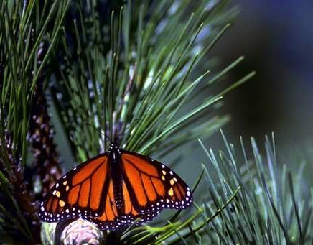
Eternal Priorities
God
God's Word
Souls of People
Notes:
Which matters more? God or Money?
Do you give proportional to God’s supply?
Do you incur credit card debt so you can live above your means?
God’s Word
How is your Bible reading?
What is your goal in God’s Word? Have you committed to read chapter a day? Have you committed to read a verse a day? If you don’t have a target, you are sure to miss it.
Souls of People
Are you committed to getting to minister to God’s people here at this church? How?
How much are you praying for the lost?

Slide 105
Black

Slide 106


OT Sermons link at BibleStudyDownloads.org
Get this presentation and script for free!

